Slide 1
E-Voting using blockchain
Harshith Kumar. K 1602-20-737-135
Shoaib Aleemuddin 1602-20-737-170
Guide: Dr. Anjani devi

Slide 2

Agenda
PROBLEM STATEMENT
ABSTRACT
METHODOLOGY
OUTPUT
FUTURE SCOPE

Slide 3
Problem statement
Traditional voting systems are often plagued by issues such as lack of transparency, potential fraud, and inefficiencies in the counting process. Additionally, there are concerns regarding the security and integrity of electronic voting systems, particularly those that rely solely on centralized databases. These challenges undermine trust in the electoral process and can lead to disenfranchisement and doubts about the legitimacy of election outcomes. E-voting using blockchain technology presents a promising solution to address the shortcomings of traditional voting systems.

Slide 4
Abstract
In our proposed system, each vote is recorded as a transaction on a blockchain network, where it is cryptographically secured and timestamped. The decentralized nature of the blockchain ensures that no single entity has control over the voting process, reducing the risk of manipulation or tampering. Additionally, the transparency of the blockchain allows voters to verify that their votes have been accurately recorded and counted.
Smart contracts can be utilized to automate various aspects of the voting process, such as voter authentication, ballot distribution, and tallying of votes. These smart contracts execute predefined rules and protocols, further enhancing the efficiency and integrity of the system.
Furthermore, the use of blockchain technology enables auditors and election officials to conduct post-election audits with ease, as all voting data is stored on the blockchain ledger.

Slide 5


Proposed model
Voter Login
End user(Home page)
Cast a Vote
Admin login
Candidate Management
View Ledgers
Results
Voter Management
Vote validation
Log out

Slide 6


Methodology
Enter Adhaar ID and OTP
Authenticate voter
Invalid
Commit Transaction
Valid
Valid
Invalid
Select Candidate
Allow Voting
Add Digital Signature
Validate Transaction

Slide 7


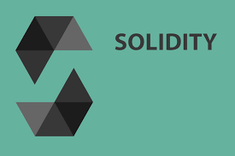
Smart contract connection:
After writing smart contract using solidity code connect it with ganache using .json file where local host is specified, and contract gets connected with it when truffle commands are executed.
Truffle compile
Truffle migrate
Truffle test

Slide 8
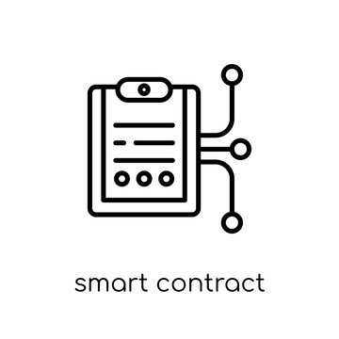

Testing smart contracts:
After deploying smart contracts using truffle migrate command, we can test it in remix.etherium website where we can observe how much gas it consumes to run a transaction and the hash values of transaction that is mined with the block number where it is stored.

Slide 9

Assign Ether values(Token) to voters:
After smart contract validation, token is assigned to each voter to vote. It helps to maintain secure voting where only one vote for each voter login account. Assigning of token will be validated by using MetaMask connection where it has private key different for each voter.

Slide 10
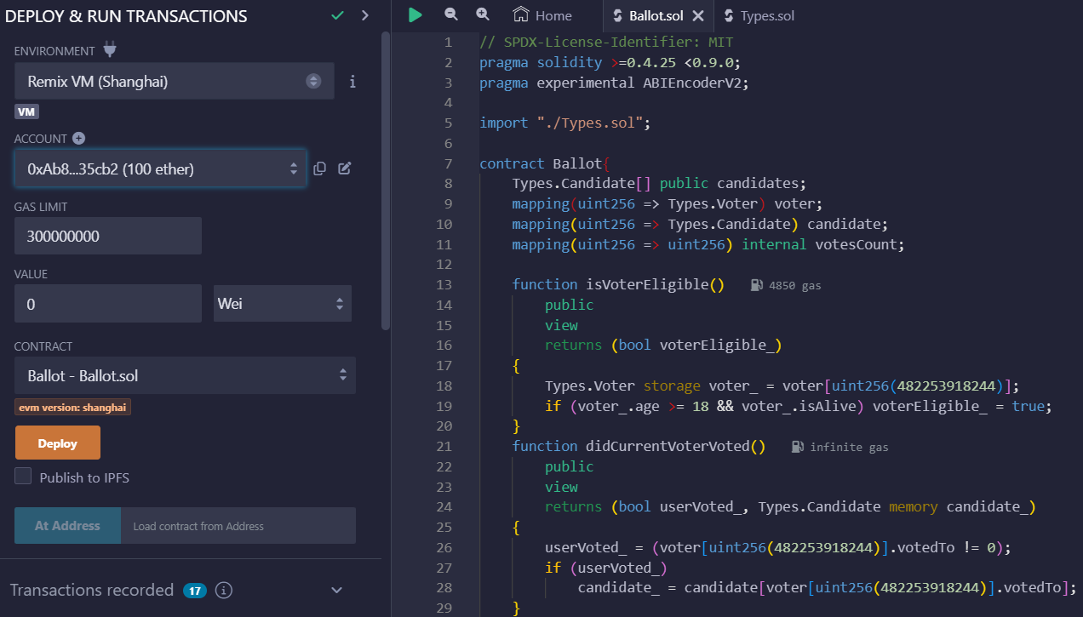
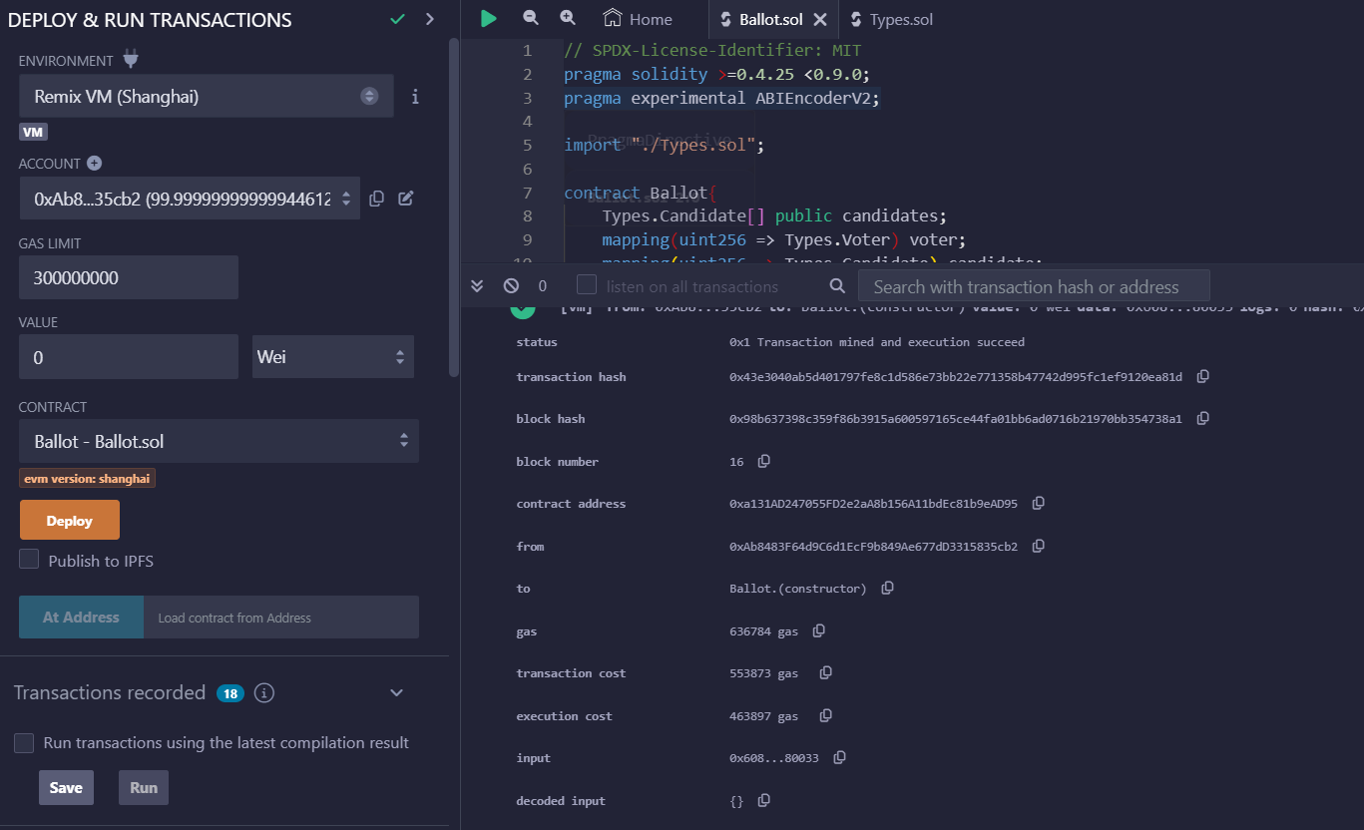
Output

Slide 11
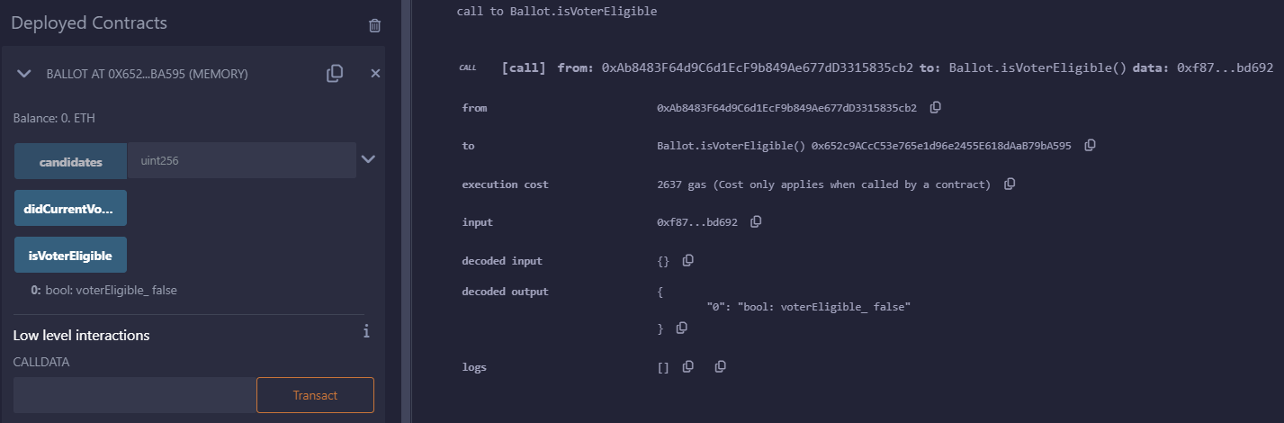

Slide 12
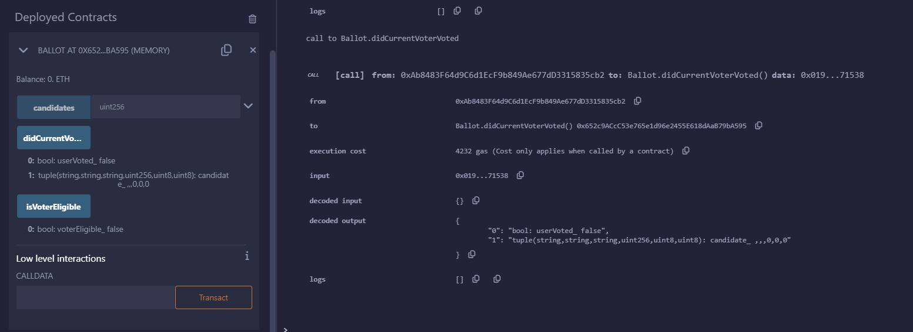

Slide 13
For the next review
Implementing all smart contracts with calls like getting candidate list from database, checking whether vote is eligible or not with ganache and MetaMask.
Design front end for admin and voter login
Result page showing whether vote is taken into consideration or not and also a ledger page showing transactions that happened in voting process.

Slide 14
Future scope
Multi-Factor Authentication :
Biometric verification, such as fingerprint or facial recognition, adds an additional layer of security by confirming the identity of voters based on unique physical characteristics.
User-friendly interfaces with customizable features :
providing alternative voting methods, such as remote voting via mobile devices or paper ballots for in-person voting, ensures that voters can participate in elections regardless of their access to technology or internet connectivity

Slide 15
Thank you

